Slide 1
A Review of LedgerGuard: Improving Blockchain Ledger Dependability
Sajan Maharjan
20182095
CSED601 Dependable Computing

Slide 2
Purpose
Partial Requirement of CSED601 Course
Term Paper
Study on Dependability aspects of blockchain technology
One of the components (case study)
Additional case studies to be presented later

Slide 3
Contents
Blockchain & Dependability
LedgerGuard
Hyperledger Fabric
LedgerGuard Mechanism- Corruption detection & recovery
Evaluation
Conclusion

Slide 4
Blockchain & Dependability
Blockchain
Portmanteau of block (storing information) and chain (links)
Distributed, decentralized, immutable, append-only ledger of records
Underlying technology of Bitcoin, started in 2008
Maintaining ledger integrity and security is one of the crucial design aspects of any blockchain platform
Dependability
Availability
Reliability
Safety
Integrity
Maintainability

Slide 5
But Isn’t Blockchain already secure?
Yes! It is relatively secure
Distributed, decentralized copy of records (Node Failure Tolerant)
Makes use of cryptographic hashes and consenus protocols (algorithms) to validate and verify blocks
No! There have been compromises
Bitcoin Hacks (Mt. Gox)
Sybil Attacks, DDoS
Application Level Vulnerabilities

Slide 6
But Isn’t Blockchain already secure?
Also
Blocks running on a blockchain node over an extended period of time can be corrupted due to software or hardware failures. (Magnetic disk or SSD failure)
Antivirus software or firewalls may delete or corrupt files relating to blockchain.
Low probabilistic success at tampering data
“In private Blockchains such as Hyperledger Fabric or R3 Corda, it is critical to maintain the nodes hosting peers highly secure. However, when a peer is hosted in a less secure environment, an external attacker or malicious user can hack into the peer node and modify the content of the ledger files.” - Qi Zhang et al

Slide 7
LedgerGuard
A tool to maintain ledger integrity by detecting corrupted blocks and recovering these blocks by synchronizing with the rest of the network
Based on Hyperledger Fabric (permissioned, open source blockchain platform)
Integrity of records in blockchain is essential before executing any analytical or auditing applications on the records
Not used to check the integrity of incoming node data, but used to check the integrity of existing node data
“However, the peer lacks the capability of detecting and recovering the corrupted blocks existing in the ledger during its runtime.” - Qi Zhang et al

Slide 8
LedgerGuard
A runtime self correction mechanism for ledger
Enforces integrity using two techniques-
First, it validates the contents of each block and the hash links between each blocks
Second, if corrupted block is identified, LedgerGuard recovers the block and corrects the affected part of ledger without the need for rebuilding the whole ledger.
Can be used as a tool (by an operator) or started as a service

Slide 9
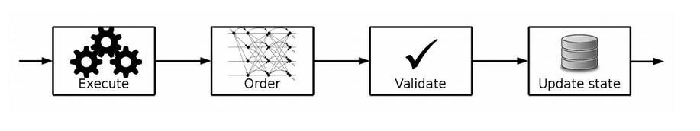
Hyperledger Fabric
Permissioned blockchain platform suitable for enterprises
Byzantine Fault Tolerance Consensus Algorithm
Orderer signs the transaction using certificate issued by CA
Fig. Transaction flow in Hyperledger Fabric

Slide 10
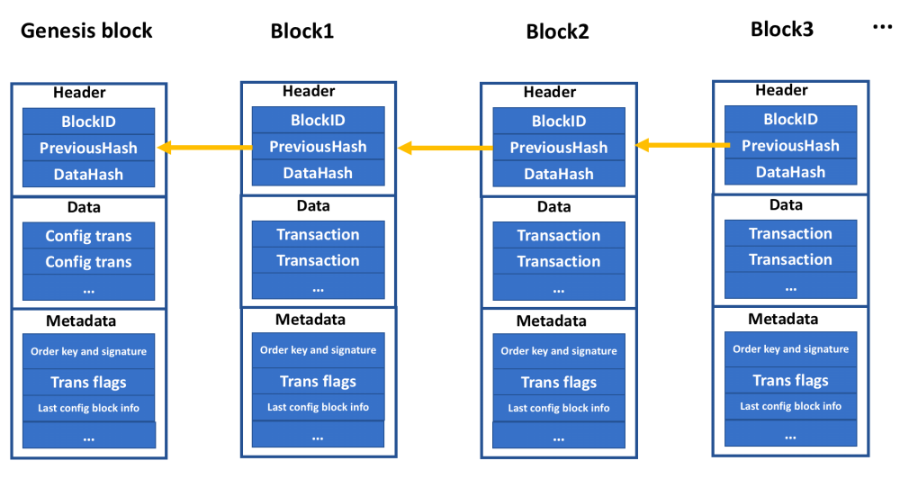
Hyperledger Fabric (contd…)
Fig. Block structure in hyperledger fabric
Notes:
Each block has three sections: block header, block data, and block metadata. The block header section includes the sequence number of this block, the hash value of the previous block, and the hash value of the data section in the current block. The block data section contains a series of transactions with some additional information such as the read/write sets and the endorsers’ signatures. For the medadata section, it incorporates the certificate, public key and the signature from the orderer.

Slide 11
Ledger Corruption Detection
Like integrity maintained in blockchain, LedgerGuard validates integrity from two aspects-
Each single block in the ledger is not corrupted
The hash pointers between the blocks are valid
To validate a single block, LedgerGuard uses the certificate of the ordering service to validate the correctness of each block header.
To validate the correctness of the hash pointer, LedgerGuard calculates the hash value of the current block and compares it with the value of “PreviousHash” of the next block

Slide 12
Corrupted Ledger Recovery
A corrupted block is recovered by sending a request to its peers asking for the block with the same ID.
Sometimes multiple blocks need to be retrieved to fix the ledger even though only one block is corrupted.
In hyperledger fabric, a ledger consists of one or multiple fixed size files, and each file contains continuous series of blocks. A corrupted block can be larger or smaller than the size of the correct block
Replacing block A with the correct block A’, but of different size will overwrite part of the successive blocks or leave a gap in between

Slide 13
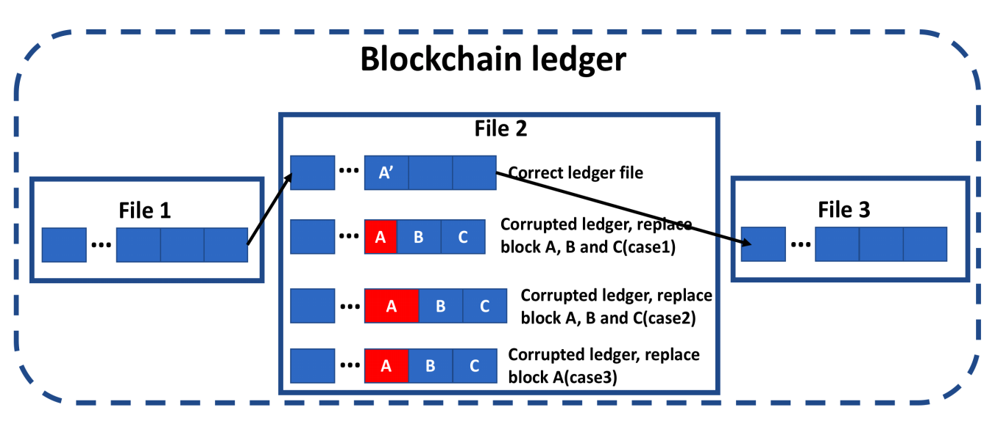
Corrupted Ledger Recovery
Fig. Blockchain ledger stored in files

Slide 14
Corrupted Ledger Recovery
So, LedgerGuard first checks the size of the corrupted block against the correct block in the peers.
If the size of the corrupted block when replaced with the correct block doesn’t overlap or gap the successive block, only the corrupted block is replaced.
Else, all the blocks in that file is replaced.

Slide 15
Execution & Evaluation
Tested on 4-core Vmware virtual machine, with Intel® Xeon® CPU E5-2698 2.2GHz with 4GB of RAM
Ledgers were generated using a tool that simulates the block generation on a real Hyperledger Fabric blockchain.
4 peers hyperledger fabric blockchain network

Slide 16
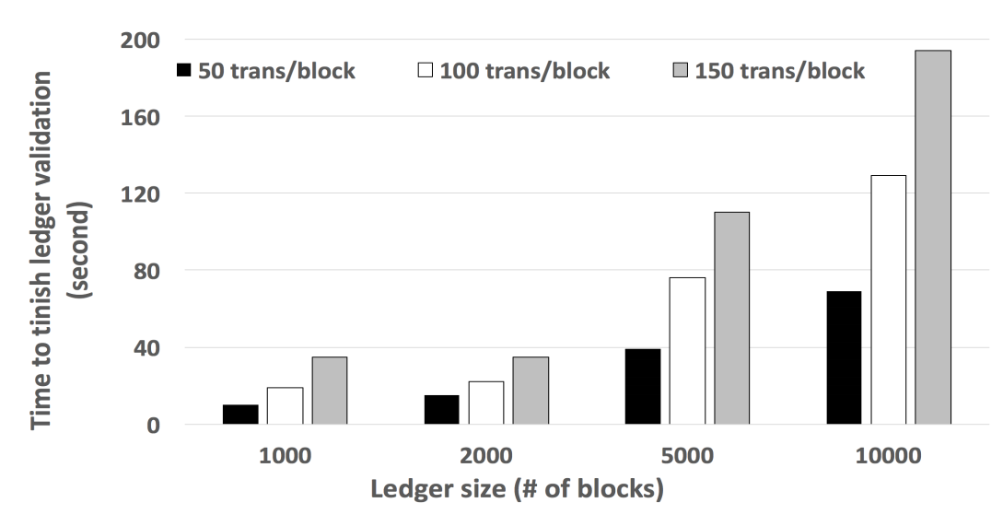
Execution & Evaluation
Fig. LedgerGuard ledger validation time
LedgerGuard sequentially scans through each block in the ledger- O(n) complexity

Slide 17
Execution & Evaluation
Uses 60MB memory
CPU Utilization starts with 110% and then drops to 20%- the initial spike is due to the need to do some initialization work such as opening the ledger, reading configuration of the blockchain network, etc
Given a block size of 150 transactions per block, LedgerGuard can fetch blocks from another peer, validate and commit at the speed of 8.5 blocks per second

Slide 18
Conclusion
An existing blockchain maybe corrupted due to several reasons- hardware or software failure, blocked or deleted by antivirus software or malicious node inside private networks
LedgerGuard- a runtime mechanism for maintaining the ledger integrity for HyperLedger fabric
Detects and corrects block errors by synchronizing with the rest of the network.
A prototype was implemented and its effectiveness was evaluated

Slide 19
References
Behind the Architecture of Hyperledger Fabric, https://www.ibm.com/blogs/research/2018/02/architecture-hyperledger-fabric/
Zhang Q. et al, LedgerGuard: Improving Blockchain Ledger Dependability, (2018), https://arxiv.org/pdf/1805.01081.pdf

